Slide 1

GCTConnect: A College Social Networking Platform
Revolutionising campus communication and resource sharing.

Slide 2
Addressing Communication Challenges
The current WhatsApp-based system for college communication faces significant inefficiencies, leading to delays and information gaps.
Principal Messaging
Manual Group Management
Messages from the Principal go through multiple layers (HoDs, CR Groups) before reaching students, causing delays.
Adding members to WhatsApp groups is time-consuming and prone to errors, especially with large student numbers.

Slide 3
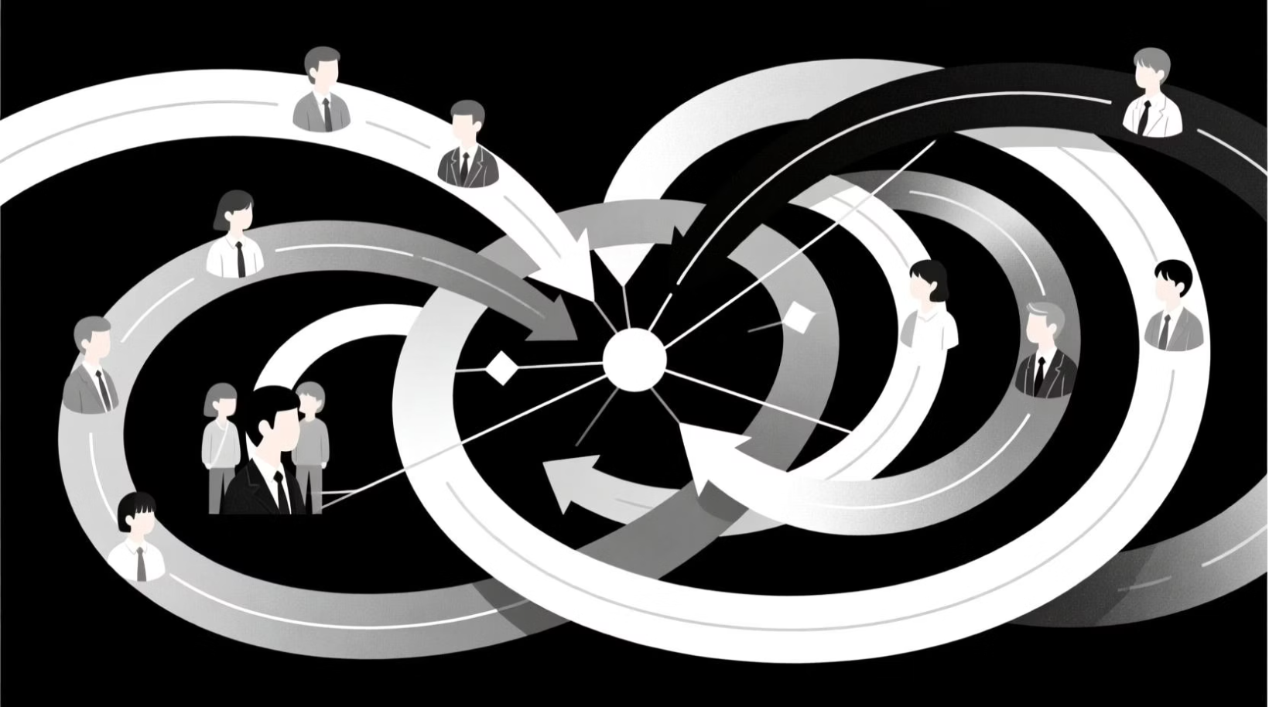

Streamlined Direct Messaging
Current Issue: Layered Communication
GCTConnect Solution: Direct to Group
On WhatsApp, Principal's messages to students are routed via HoDs and CR Groups, creating unnecessary intermediaries.
GCTConnect enables the Principal to send messages directly to any required group, bypassing intermediaries for efficiency.

Slide 4



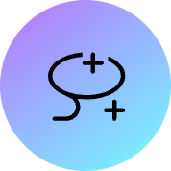

Automated Group Membership
Manual Addition
WhatsApp groups require manual addition of each member, which is time-consuming and error-prone for large classes.
Automatic Integration
GCTConnect automatically adds members to groups based on their department, batch, or class, even for late joiners.

Slide 5


Permanent Document Storage
WhatsApp: Ephemeral Sharing
GCTConnect: Persistent Access
Documents shared by seniors on WhatsApp are not permanently accessible to juniors, leading to repeated requests and searches.
All important documents shared on GCTConnect are saved permanently, ensuring easy access for future batches.

Slide 6
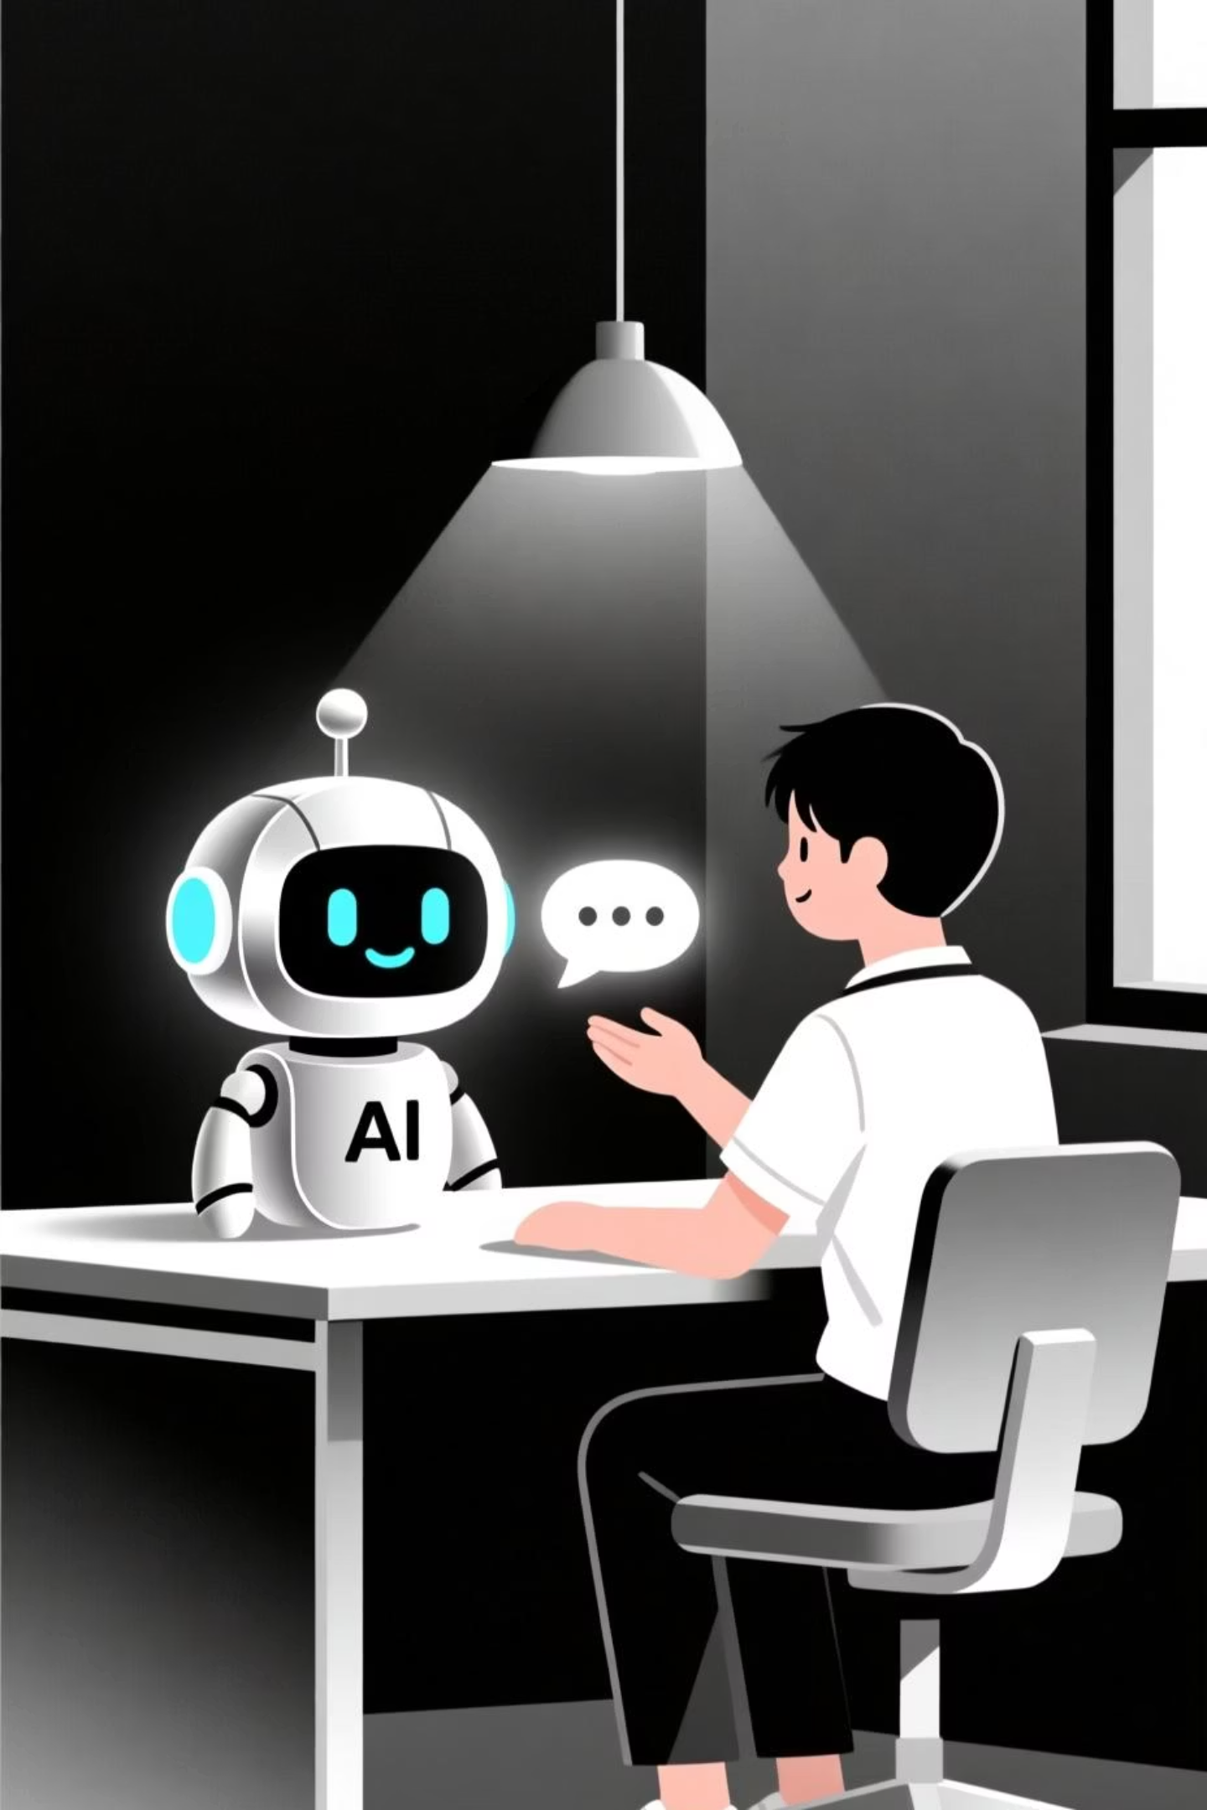

Built-in Chatbot for Queries
GCTConnect integrates a chatbot to provide instant answers to common student questions, reducing the burden on staff and seniors.
Current: Repetitive Questions
Students frequently ask seniors or management basic questions, leading to repetitive queries.
GCTConnect: Instant Answers
The chatbot handles common queries (e.g., timetable, exam dates, notices) instantly, improving efficiency.

Slide 7




Our Team & Roles
Meet the dedicated team behind GCTConnect, bringing diverse expertise to build a robust platform.
Talha - Team Leader
Awais - Frontend Developer
Majid - Module & Data Handling
Responsible for core backend architecture, database design, and ASP.NET Core integration.
Works on responsive UI design and integrating pages with backend APIs for a smooth user experience.
Handles documentation and chatbot integration.

Slide 8






Technology Stack
GCTConnect is built on a modern and robust technology stack to ensure performance, scalability, and security.
ASP.NET Core MVC
C#
Framework for building robust web applications.
Primary programming language for backend logic.
SQL Server
SignalR
Relational database management system for data storage.
Websocket to handle real time communication.
JavaScript
AI Chatbot API
Client-side scripting for interactive web pages.
Integration for intelligent query handling.

Slide 9
Future Scope & Conclusion
GCTConnect aims to evolve into a comprehensive college social networking platform, continually enhancing the student experience.
1
Continuous Improvement
2
Expanded Integrations
3
Mobile Applications
Potential integration with other college systems (e.g., learning management systems).
Development of dedicated mobile apps for iOS and Android for enhanced accessibility.
Further development of features based on user feedback and emerging needs.
GCTConnect is set to transform college communication, making it more efficient, accessible, and user-friendly.

